Slide 1

Sources of Finance

Slide 2

Types of Finance
Finance is money used to fund a business
The two main types are:
Debt Financing
This is when money is borrowed. The money has to be paid back, even if no profit is made.
2. Equity Financing
This involves part ownership of the business to an investor in exchange for some of the start up costs needed.

Slide 3

Internal or External Finance
Internal Finance:
This comes from sources within the business, such as capital by the owner(s).
2. External Finance:
This comes from sources outside the business,
such as loans or mortgages.

Slide 4

Types of Internal Finance
Internal Finance includes:
Retained profits – this is profit that the business has retained rather than spent. Retained profits can be invested back into the business. It is useful as it does no incur fees for using it.
Working capital – this is the money needed for everyday business expenses eg. paying wages, buying stock, rent, advertising expenses.
Personal savings – this is savings an individual has in their personal bank account that is used in the business.
Sale of Assets – Assets such as motor vehicles, computers, machinery can be sold. Useful if there is a surplus of assets eg. Computers that are not needed.

Slide 5

External sources of finance
Line of credit from creditors
Trade credit is given when a business purchase items, such as raw materials from a supplier. The supplier may let the business purchase goods on credit with payment terms varying between 30 and 90 days. The business receives the materials now but pays for them later. This is usually interest free.
2. Overdraft
This is an agreement with a bank to be allowed to overdraw cash to a specific amount. Interest is charged when the account is overdrawn.
3. Lease
This is between a leasing company and the business. The leasing company owns the asset while the business pays for using (leasing) them. Often motor vehicles are leased.

Slide 6

External sources of finance
4. Crowdfunding
This involves raising funds online, through social media or crowdfunding websites. Generally those providing funding expect to receive a copy of the final product or something in return.
5. Loan
Businesses can apply for a loan from a bank or other financial institution. Interest is charged on the loan and there are monthly repayments.
6. Grant
A grant is a sum of money given for a specific purpose. Many grants are available for young business people wanting to start their own business. Grants may come from the government and/or private organisations. Grants do not need to be paid back.

Slide 7

External sources of finance
7. Mortgage
A business can take out a mortgage to purchase non-current assets such as land and buildings. Mortgages are long term, 15-30 years. The land or building will become property of the bank or lending society if repayments can not be made. Due to the security and length, interest is charged at a lower rate.
8. Family & Friends
This is when family and/or friends inject money into the business.
9. Share capital (for companies only)
Companies sell shares to their shareholders to raise finance. The shareholder owns a portion of the company and can share that portion of profit. While the company receives capital, the money that is paid for the share/s.

Slide 8
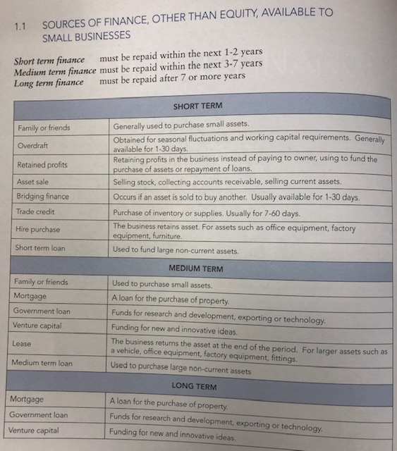
Short Term:
Usually to cover day to day (working capital) expenses. Needed for a short period such as 3 months.
Medium Term:
A mix of working capital and capital expenditure (Capital expenditure eg. Machinery, office building, fixed assets). Needed for 3 – 7 years.
Long Term:
Usually for capital expenditure. Needed for over 7 years.
Source: A & F WACE Study Guide: Academic Associates

Slide 9
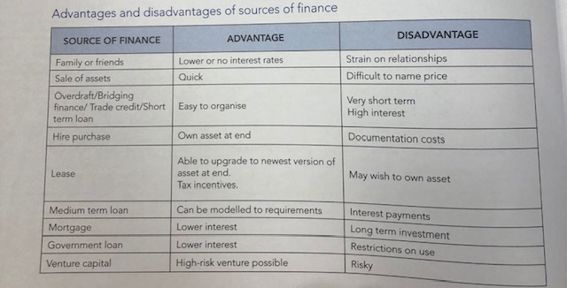
Source: A & F WACE Study Guide: Academic Associates

Slide 10
Questions:
What is the difference between capital expenditure and working capital?
What is the difference between debt financing and equity financing?
What is the difference between internal and external finance?
What are retained profits?
List and explain two sources of internal finance.
List and explain two sources of external finance.
List and explain a source of finance that is available to a small proprietary company but is not accessible by a sole trader.

Slide 11
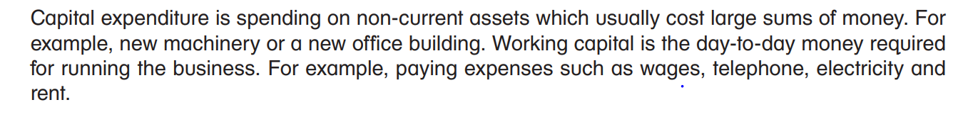

Questions:
What is the difference between capital expenditure and working capital?
What is the difference between debt financing and equity financing?
3. What is the difference between internal and external finance?
What are retained profits?
List and explain two sources of internal finance.
List and explain two sources of external finance.
List and explain a source of finance that is available to a small proprietary company but is not accessible by a sole trader.

Slide 12
Source: E. Criddle & K. Kania, (2014) Accounting and Finance A resource for Year 11 ATAR/Year 12 General, Cottesloe: Impact Publishing

